Slide 1
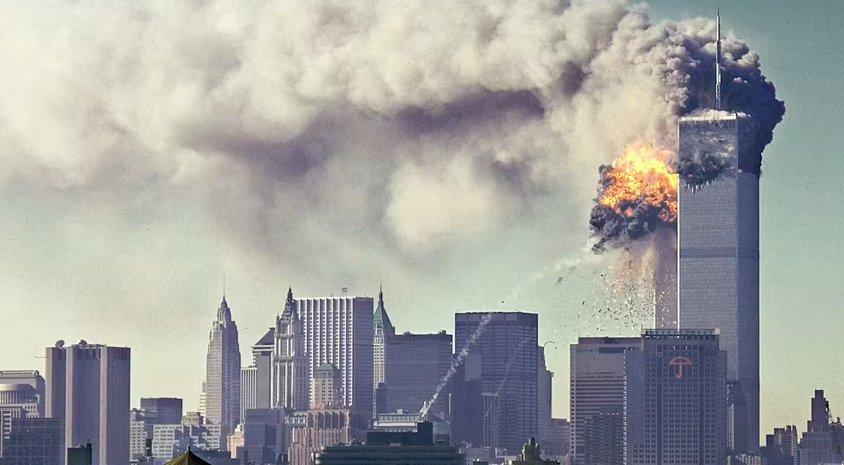
Terrorism in the United States
Ross Brinkerhoff Assignment 20.3.2 | June 2024
NIST SIPA/Wikicommons
Notes:
When we think about Terrorism in the US.
I think most people think of an image like this – 9/11 image.

Slide 2
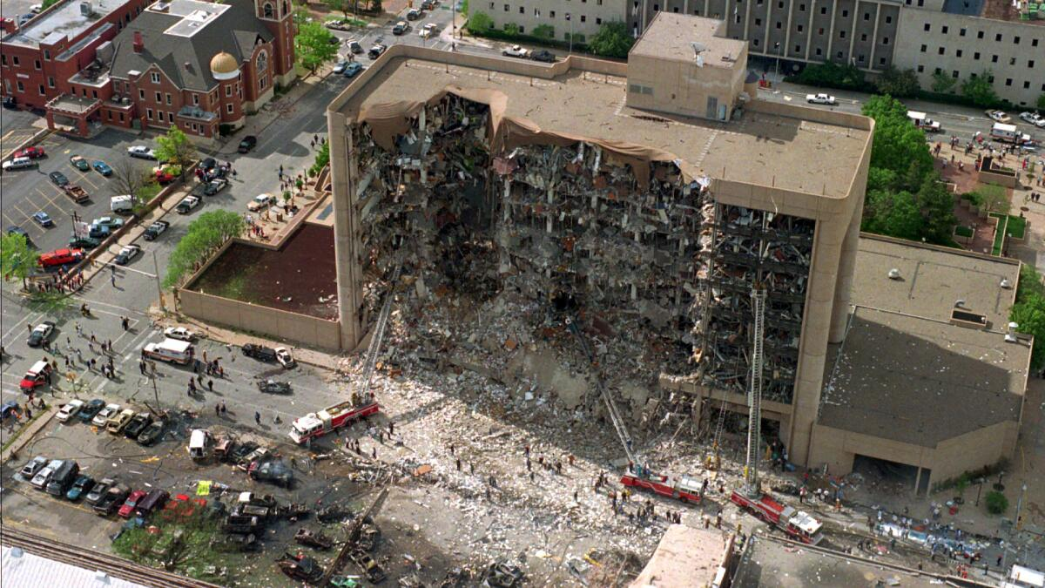
Creator: Anonymous | Credit: AP
Notes:
Or this, from the bombing in Oklahoma city in the 1990’s
Terrifying and extraordinary acts of violence. But at least for me only a few attacks come to mind.
In a country as large as the US - I knew there had to be more to the story.
And there is....

Slide 3
Global Terrorism Database
50
years
209,706
attacks
3,725
Groups/attackers
Notes:
To find out I looked at the global Terrorism Database
Maintained by the University of Maryland
tracks Terrorism worldwide
1970-2020 – Additional annual updates coming
The attacks in the US are just 1.5% of all the data here.

Slide 4
3,121
U.S. attacks
Notes:
3,121 attacks in the US over that time frame
Carried out by 244 different groups
There is definitely more to the story than 9/11 and Oklahoma city
But how are these attacks distributed across the 50 years we have data for?

Slide 5
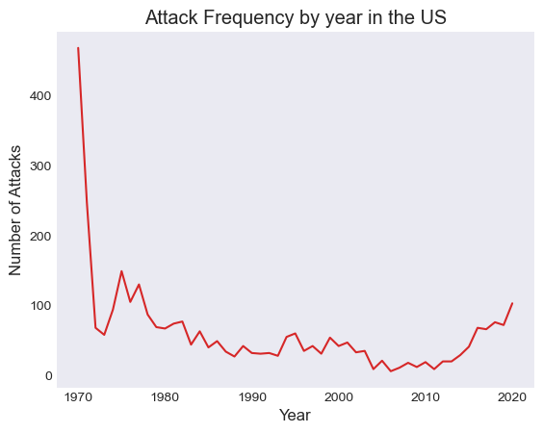
Notes:
Here’s attack frequency in the US.
We see a high in the 70s. With more than 1 attack per week.
Then it tapers off through the 80’s and 90’s,
and starts to go back up after 2010
After 2010…

Slide 6
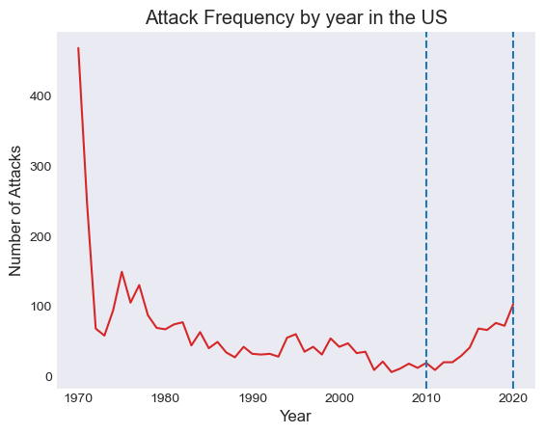
Notes:
this is actually and over 5 fold increase in attack frequency – making 2020 comparable to 1976.
In fact, the years where 9/11 happened, and Oklahoma city, seem somewhat quiet.
So that’s the number of attacks – let’s look at deaths

Slide 7
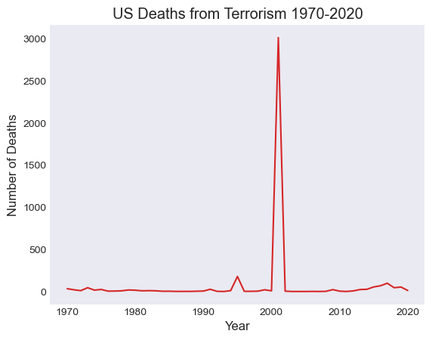
Notes:
Here they both are
9/11 is not typical
All 4 events in 9/11 taken together are the worst attack in the data set that I could find.
and 9/11 is a massive outlier in the US and globally
If these big attacks are outliers
So what are other 3000 + attacks for the US?
Before we explore those ,I want to say something about ambiguous cases in the data

Slide 8
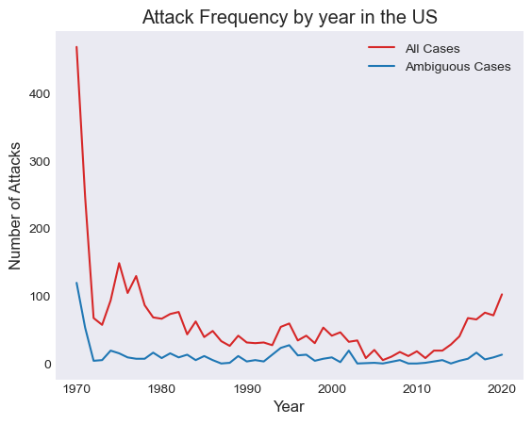
Notes:
The publishers have a fairly rigorous definition , but it’s hard to tell,
the blue line is the number of cases where the attack may not meet the strict definition.
Something happened, but it’s not clear if it’s a case of true terrorism, or just bad behavior.
About 18% of the attacks in the us are like this.
It’s also important to keep in mind as we move forward that many of the groups carrying out these attacks turn out to be unknown.
Here’s an example of the kind of ambiguity I’m talking about:
'1/2/1970: Unknown perpetrators detonated explosives at the Pacific Gas & Electric Company in Oakland, California,.
Three transformers were damaged costing an estimated $20,000 to $25,000.
There were no casualties.'

Slide 9
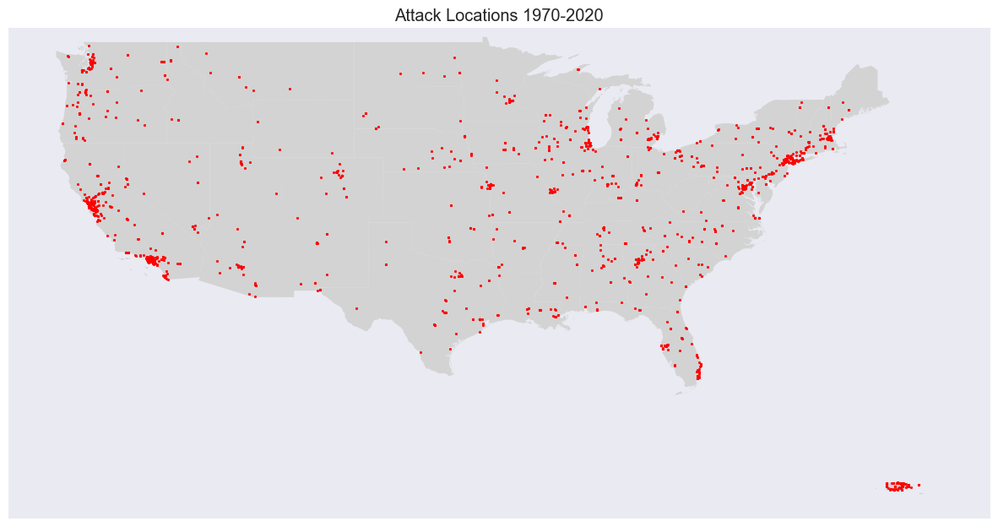
Notes:
So where are these attacks occurring?
CA is the state with the most attacks
Pretty easy to pick out major hubs
NYC is the city with the most attacks
Alaska = 1 attack
HI = 5
How are these attacks Carried out?

Slide 10
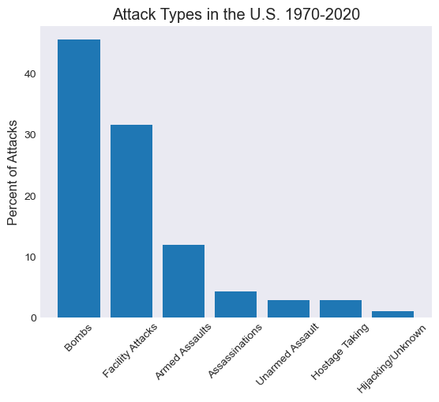
Notes:
Bombing/Explosion 1419 - 45.5% – Mostly unknown explosives – pipe bombs or dynamite
Facility/Infrastructure Attack 983 – arson, Molotov cocktails – gasoline or alcohol – fire attacks
Armed Assault 372 – guns – handguns and various rifles
Assassination 135 – Guns and explosives
Unarmed Assault 92 - beatings and poisonings
Hostage Taking (Barricade Incident) 67 – guns or knives
Hostage Taking (Kidnapping) 23 – guns or knives
Hijacking 19
So what kind of targets are these weapons aimed at in the US?

Slide 11
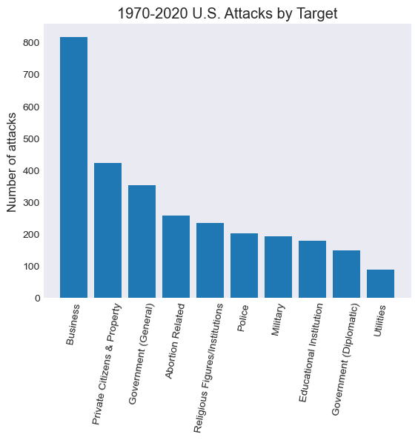
Notes:
Really almost everything.
Businesses are the most popular
Targeting the public is also popular
Government facilities
Abortion related attacks are the top attack that has an overt political agenda.
These are just the top 10 – the target list is long, but as we’ll see, it changes over time.
Even with all this bombing and arson and armed assault on all these targets - How many people are dying

Slide 12
77% of attacks result in no casualties
93% of attacks have one fatality at most
Notes:
77% of attacks have no recorded casualties at all
Almost 93% have one fatality at most
3/6/1995
Two attackers ignited a fire at the Tidewater Women's Health Center in Norfolk, Virginia. The abortion clinic sustained $5,000 in damages.There were no casualties
So what about the people or groups doing this?
How long are they active and how many attacks are they doing?

Slide 13
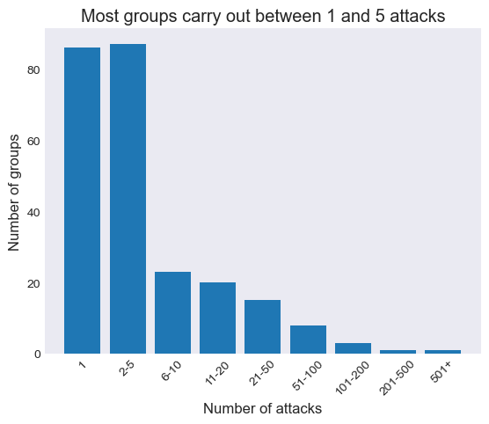
Notes:
Of the 244 groups carrying out attacks in the data
Most were active for a year or less,
and carried out between 1 and 5 attacks
most of which didn’t hurt anyone.
But what about the big spike in the 1970’s and the increasing attacks in the 2010s, do they fit these trends?
What can those decades of higher attack frequency show us about Terrorism in the US more broadly.

Slide 14
Terrorism in the 1970s
1,475
attacks
144
unique attackers
183
deaths
Notes:
Let’s start with the 70’s –
Largely fits the general pattern
The spike in the 1970’s saw at least one attack from 144 unique attackers
Note that one of those is an unknown category.
183 deaths - not a high death rate
02/16/1978:
Unknown Puerto Rican nationalists bombed Woolworth's Department store in San Juan, Puerto Rico. Explosion caused a fire and major damage. One of 5 bombings that day at department stores and banks. No casualties.

Slide 15
Terrorism in the 2010s
523
attacks
43
unique attackers
390
deaths
Notes:
The 2010 was worse - fewer groups and fewer attacks - higher death toll – but still seems to broadly fit the pattern of large numbers of attacks with low casualty rates.
390 deaths - Still less than 1 fatality per attack
Most of these are not mass casualty events.
That said – they do occur
166 of these deaths are from 5 mass shootings that were labeled as terrorism:
2015 - San Bernadino Shooting - Jihadi-inspired extremists - 16 fatalities
2016 - Pulse Nightclub Shooting - Jihadi-inspired extremists - 50 fatalities
2017 - Mandalay Bay LV Shooting - Anti-Government extremists - 60 fatalities
2018 - Parkland Shooting - White supremacists/nationalists - 17 fatalities
2019 - El Paso Walmart Shooting - White supremacists/nationalists - 23 fatalities
So both the 70’s and the 2010’s seem to fit the broader pattern.
But…the spike in the 70’s and the increase in the 2010’s are different as well. They each have a signature in terms of the attackers, the methods and the targets.

Slide 16
The Attackers Have Changed
1970s
Black Nationalist/ Power
Communist Groups
Cuban Independence/ Anti-Castro
Puerto Rican Independence
National Liberation Movements
Anti-War Groups
Environmental Groups
2010s
White Nationalists
Militia Groups
Islamists
Pro and Anti LGBT
Pro and Anti Religion
Conspiracy Theory Groups
Trump Related Extremists
Notes:
They share almost no groups in common.
The groups are largely unique to the decade and reflect the politics of the time.
1970s example:
3/12/1970: In a series of related attacks, the Revolutionary Force 9 claimed credit for the bombing of the Mobil Oil Company Building in Manhattan, New York, United States. There were no casualties but the building sustained heavy structural damage. The Revolutionary Force 9 claimed that the Mobil Oil Company was an "enem(y) of human life" because it profited off of the Vietnam War.
2010 example:
'03/31/2020: An assailant derailed a locomotive in an attempt to have it crash into the United States Navy Hospital Ship Mercy at the Port of Los Angeles in Los Angeles, California, United States. There were no reported casualties in the attack. Eduardo Moreno, a train engineer, confessed to intentionally derailing the train in an attempt to "wake people up" about the presence of the hospital ship. He was suspicious that the ship may have been docked to spread COVID-19 or to facilitate a government takeover.'

Slide 17
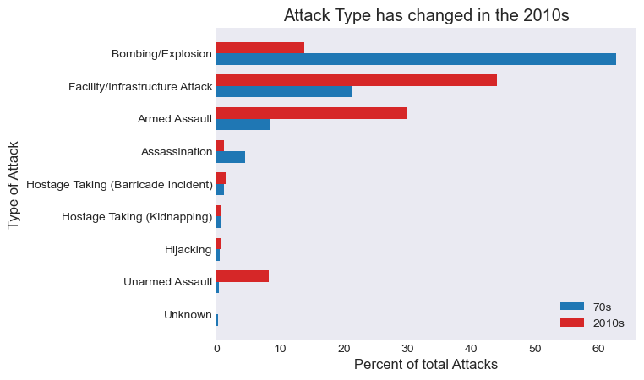
Notes:
The types of attacks are different

Slide 18
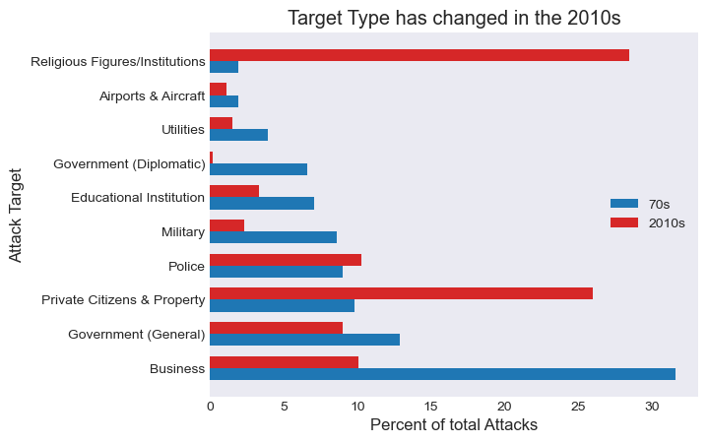
Notes:
The targets are different
So what do these different patterns tell us about terrorisim in the us as a whole.

Slide 19
Large Mass Casualty Events are Rare
TAKEAWAY:
Notes:
9/11 is not typical, nor is Oklahoma city or even large mass shootings.
They may seem more common than they are because they make the news and are shocking.

Slide 20
Terrorist Attacks may be increasing
TAKEAWAY:
Notes:
5x increase from 2010-2020 – more data is coming – we’ll see what happens
Given the political moment we’re in now and the division, a decrease in attacks seems unlikely.

Slide 21
Targets and Methods Change
TAKEAWAY:
Notes:
The targets and methods of the 2010s are different from the 1970s
Broadly Speaking:
Fewer bombings - More shootings and arson attacks on buildings.
Religious Targets instead of governments.
Targets and method change over time and will likely continue to change

Slide 22
Few Attacks and Short Active Periods are Typical
TAKEAWAY:
Notes:
It’s not a few professional militant groups (although those exist)
it’s a lot of small actors, many of them unknown, carrying out small numbers of uncoordinated attacks.
These are not military operations or professional bomb makers
This is punctuated by a massive attack sometimes, but those are not the norm.

Slide 23
Terrorist activity reflects the political moment
TAKEAWAY:
Notes:
The groups carrying out the attacks are broadly reflective of the divisive issues of the time.
Some of those issues are ongoing – Anti-Abortion and Race issues,
But a lot of them are shorter lived – Anti-war (Vietnam) - gay rights - COVID conspiracy Theories
It seems like controversial issues cause extreme views to sort of bubble up to the surface – and eventually some small number of people start to take matters into their own hands.
This isn’t a process that seems likely to stop
As new and polarizing issues come up – we should expect to see new attacks based on those issues.

Slide 24
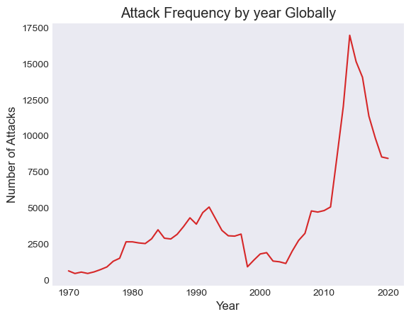
Notes:
Here is the number of attacks by year – just to give a rough idea
200k + incidents worldwide
The spike is driven largely by the wars in the middle east and associated terrorist organizations (ISIS, Taliban, Al-Queda)
Al-Queda did 9/11 – does the US experience reflect this trend?

Slide 25
Top 10 Most deadly U.S. Attacks
1991 - Lubys Cafeteria Shooting - Male supremacists - 24 fatalities
1995 - Oklahoma City Bombing - Anti-Government extremists - 168 fatalities
2001 - 9/11 - Al-Qaida - 2770 fatalities
2001 - 9/11 Pentagon - Al-Qaida - 190 fatalities
2001 - 9/11 Flight 93 - Al-Qaida - 44 fatalities
2015 - San Bernadino Shooting - Jihadi-inspired extremists - 16 fatalities
2016 - Pulse Nightclub Shooting - Jihadi-inspired extremists - 50 fatalities
2017 - Mandalay Bay LV Shooting - Anti-Government extremists - 60 fatalities
2018 - Parkland Shooting - White supremacists/nationalists – 17 fatalities
2019 - El Paso Walmart Shooting - White supremacists/nationalists - 23 fatalities
Notes:
1991 - Lubys Cafeteria Shooting - Male supremacists - 24 fatalities
1995 - Oklahoma City Bombing - Anti-Government extremists - 168 fatalities
2001 - 9/11 - Al-Qaida - 2770 fatalities
2001 - 9/11 Pentagon - Al-Qaida - 190 fatalities
2001 - 9/11 Flight 93 - Al-Qaida - 44 fatalities
2015 - San Bernadino Shooting - Jihadi-inspired extremists - 16 fatalities
2016 - Pulse Nightclub Shooting - Jihadi-inspired extremists - 50 fatalities
2017 - Mandalay Bay LV Shooting - Anti-Government extremists - 60 fatalities
2018 - Parkland Shooting - White supremacists/nationalists – 17 fatalities
2019 - El Paso Walmart Shooting - White supremacists/nationalists - 23 fatalities

